Slide 1

STOCK MARKET TREND PREDICTIONS AND ANALYSIS USING DEEP LEARNING MODELS AND VISUAL REPRESENTATIONS
SANCHITA SURYAVANSHI - 18BCE0506
KAREN PINTO – 18BCE0596

Slide 2
ABSTRACT
Most of the daily stock market traders lose their money due lack of expertise and understanding of the movement of the market, so through this project we want to bring awareness to the people who are new and not well versed with trading on the stock market as most of the traders lack experience.
And it is impossible to keep track of the performance of stocks and shares in the market every hour, every minute and every second most traders lose money.
Predicting stocks has been an old age problem which is yet to be resolved. Few of the prediction systems were implemented but the problem of stocking up the data, updating data based on time periods became a challenging task.
Hence, we are planning to solve this old age issue by implementing various deep learning models and comparing them to determine which algorithm would suit perfectly according to the situation.

Slide 3
INTRODUCTION
We have come up with a solution for ordinary traders who understand market movements and predict positive results for sure. In this case we will develop a systematic approach using existing solutions where people having minimum knowledge in this field can do investments by seeing the graphs and visualizations .
This project will use deep learning models to predict the future outcomes of the stock market, by analysing and finding the pattern in the data set provided. The model will be composed of four functions which will be evaluating several different tasks and will have separate complexity according to their use cases.
Algorithms such as LSTM, Basic RNN (Vanilla RNN), and GRU along with their bi-directional algorithms will be the ones that would be used for prediction of stocks in the market.
Along with various deep learning models, a few more agents which are stock market trading strategies will also be used to help investors to predict stock trend and help to develop stock market investment strategies. Monte Carlo and Joint Plot Visualisation are used to depict the performances of various stocks and to help people understand which stock to invest in by studying graphs and visualizations.

Slide 4
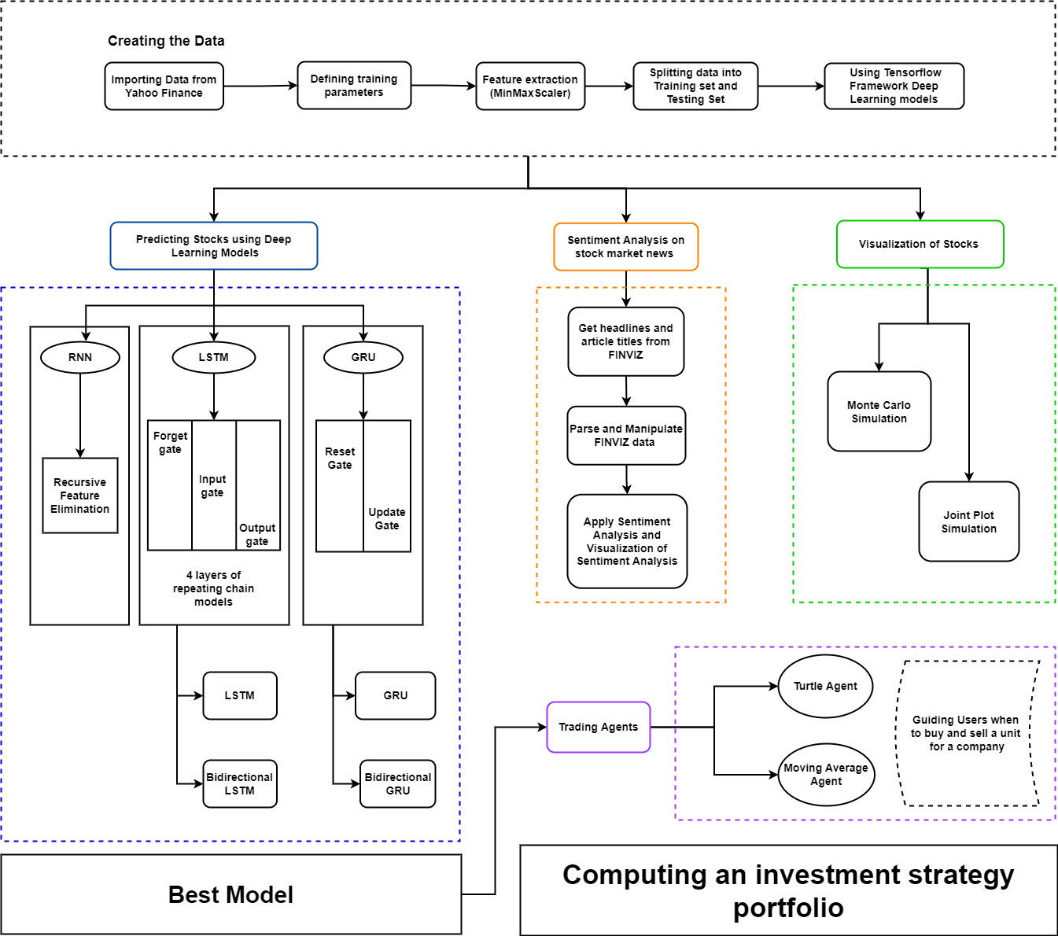
ARCHITECTURE
DIAGRAM

Slide 5
ROADMAP
Visualization
Sentiment
Analysis
Trading Agents
The simulations will help see all the possible outcomes, to understand the pattern and assess the impact of risk for better decision making.
Deep Learning Models
These agents will help investors to be able to buy or sell 1 unit per transaction.
Comparing various algorithms to find the best suited one for predicting future stocks
Process of detecting positive or negative sentiments in news articles.

Slide 6

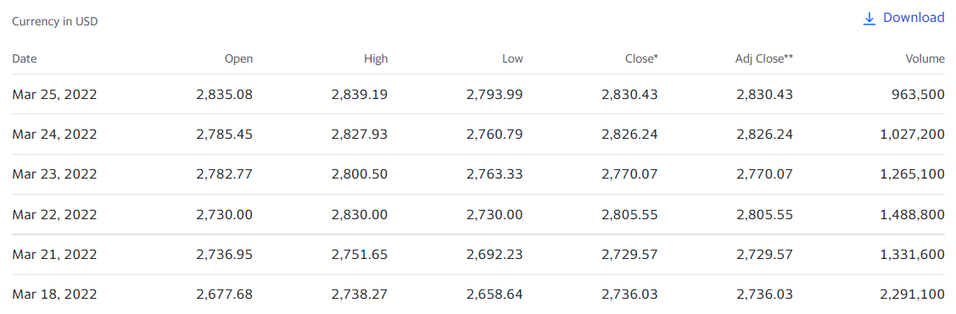
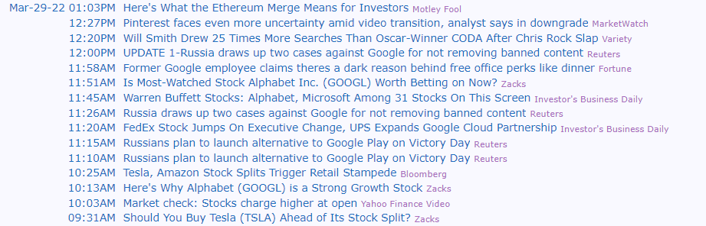
DATASET TO BE USED
YAHOO Finance
Finviz News Articles

Slide 7

ALGORITHMS THAT WERE COMPARED AND ANALYSED
RNN
LSTM & BIDIRECTIONAL LSTM
GRU & BIDIRECTIONAL GRU

Slide 8
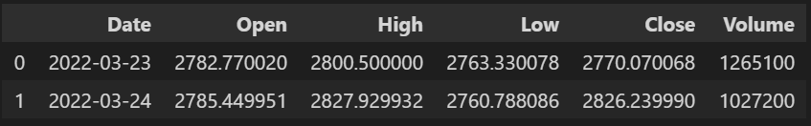
PREPARING THE TRAINING AND TARGET VALUES
x = 60 days (1-60)
y = target = 61st day’s Closing price
x = 60 days (2-61)
y = target = 62nd day’s Closing price
x = 60 days (3-62)
y = target = 63rd day’s Closing price
x = 60 days (4-63)
y = target = 64th day’s Closing price
x = 60 days (5-64)
y = target = 65th day’s Closing price
x = 60 days (6-65)
y = target = 66th day’s Closing price

Slide 9
 | Open | High | Low | Close | Volume
1 | a₁ | b₁ | c₁ | d₁ | e₁
2 | a₂ | b₂ | c₂ | d₂ | e₂
…….
60 | a₆₀ | b₆₀ | c₆₀ | d₆₀ | e₆₀
61 | a₆₁ | b₆₁ | c₆₁ | Y₁ | …
= X₁ as a 2-D Array
= X₂
= X₆₀
Day 1 | Day 2 | …… | Day 60 | Target
X1 | X2 | …… | X60 | Y = 61st Day Closing Index
X2 | X3 | …… | X61 | Y = 62nd Day Closing Index
Training Inputs
Target Value

Slide 10
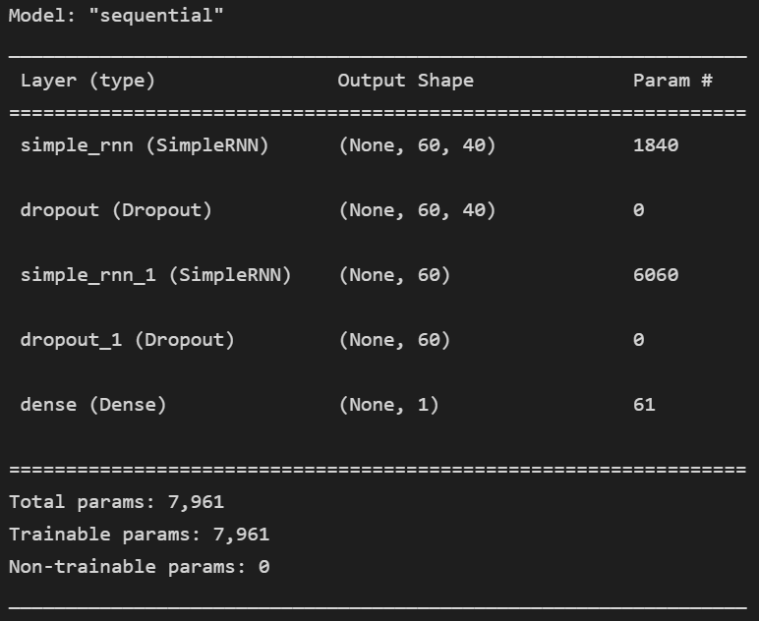
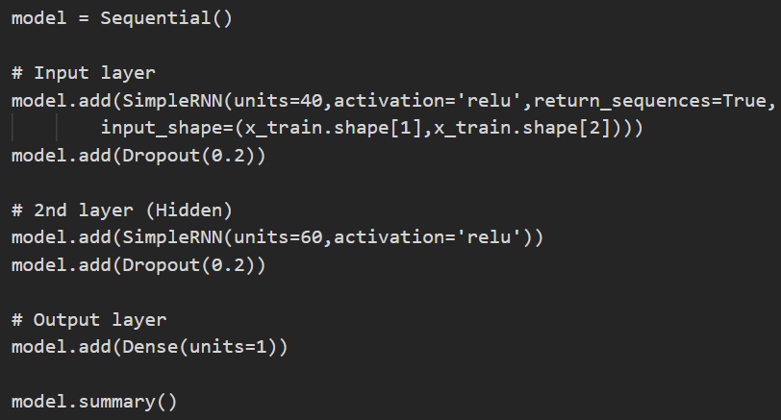
BUILDING THE MODEL

Slide 11
ACCURACY
Two types of accuracy/error computational formulas were used. Both are solely based on the mathematical distance of the predicted value from its real value.
Mean Absolute Percentage Error (MAPE)
Accuracy = (1 - np.mean(np.abs((real-predict)/real))) * 100
Root Mean Squared Error (RMSE)
Accuracy = (1 - np.sqrt(np.mean(np.square((real-predict)/real)))) * 100

Slide 12
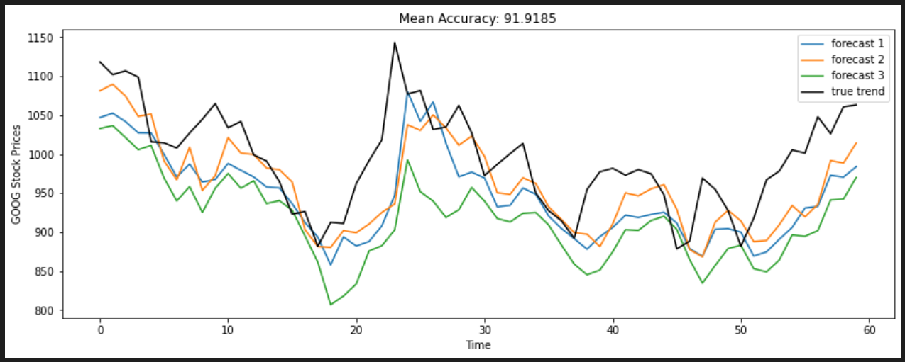
Simple RNN
For testing the accuracy of the RNN model we took google’s dataset and in the output below we ran 3 simulations and got 91.3% MAPE mean accuracy and a RMSE accuracy of 86.01%. The coloured simulations(Blue, Green and Orange) stands for the forecasted trend and the Black trend stands for the true trend.

Slide 13
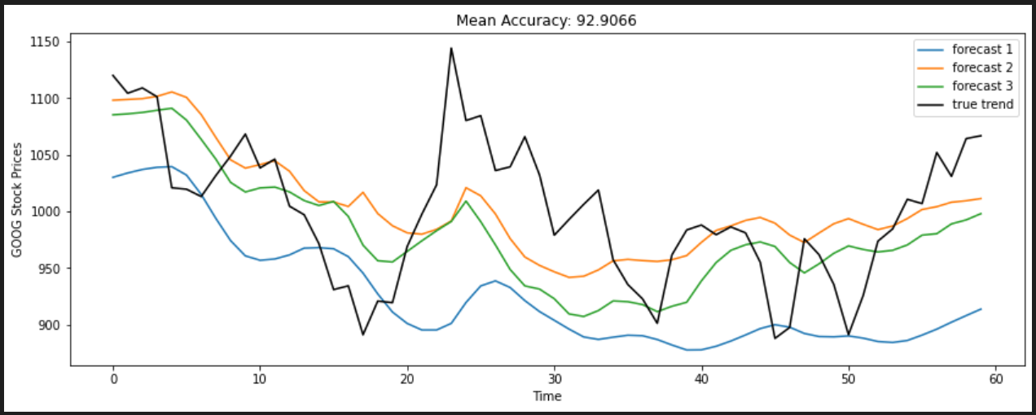
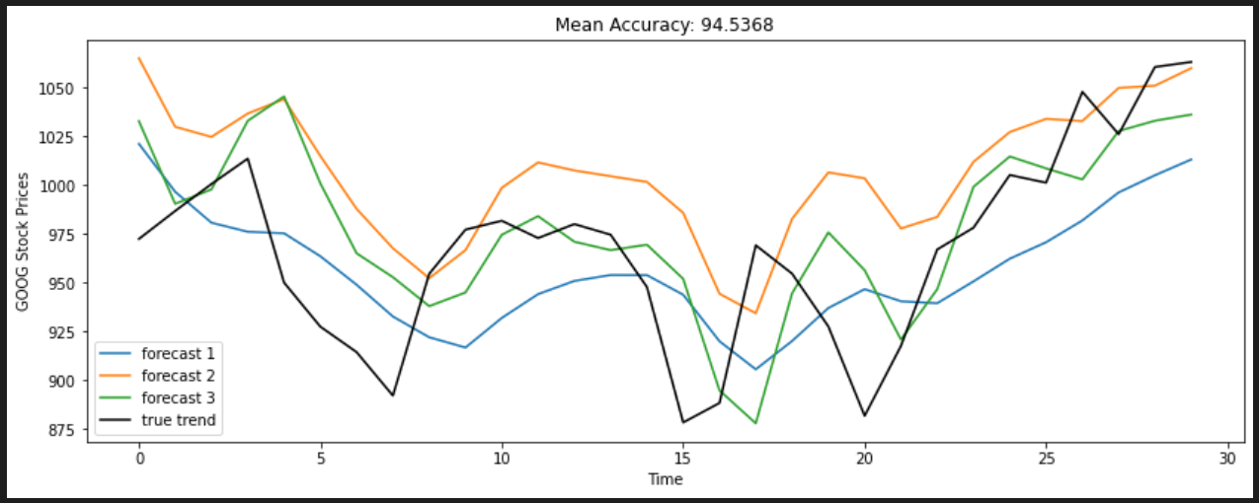
LSTM
LSTM
Bi-directional LSTM
Similarly in LSTM we ran 3 simulations and predicted the output for the stocks of google and got a MAPE mean accuracy of 92.9%.
The bidirectional version of model gives a higher accuracy if taken 30 days at a time, the Bidirectional LSTM is giving better results for google.

Slide 14
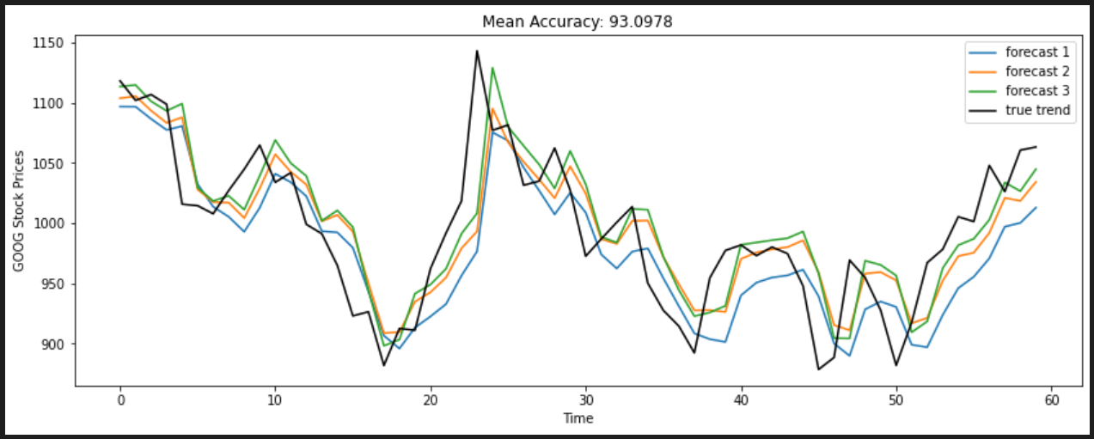
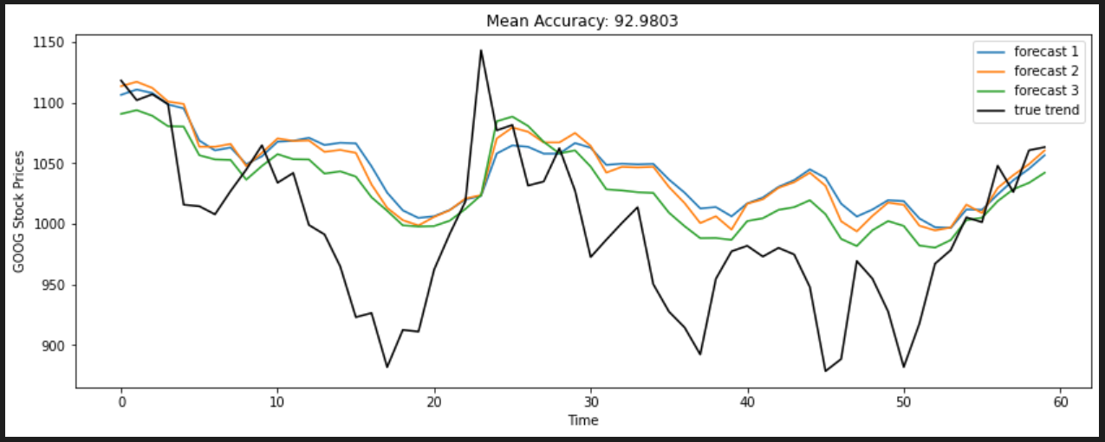
GRU
GRU
Bi-directional GRU
This model gives the best results for most of the companies. Here is a simulation for google and we got a MAPE mean accuracy of 93%.
Bidirectional GRU is working well and gives us 92.9% accuracy. We tested it on google.

Slide 15
SENTIMENT ANALYSIS
Sentiment analysis looks at the emotion expressed in a text. It is commonly used to analyze customer feedback, survey responses, and product reviews.
Sentiment analysis is used to determine whether a given text contains negative, positive, or neutral emotions.
A key aspect of sentiment analysis is polarity classification. Polarity refers to the overall sentiment conveyed by a particular text, phrase or word.
Analyzing sentiment helps to evaluate the emotion's impact in a textual context for positive decision analysis.
In the stock market, the analysis of market sentiment is valuable as it can determine the opinions of investors regarding certain stocks or assets. The market sentiment and its influence is a clear representation of the impact of trading psychology.

Slide 16
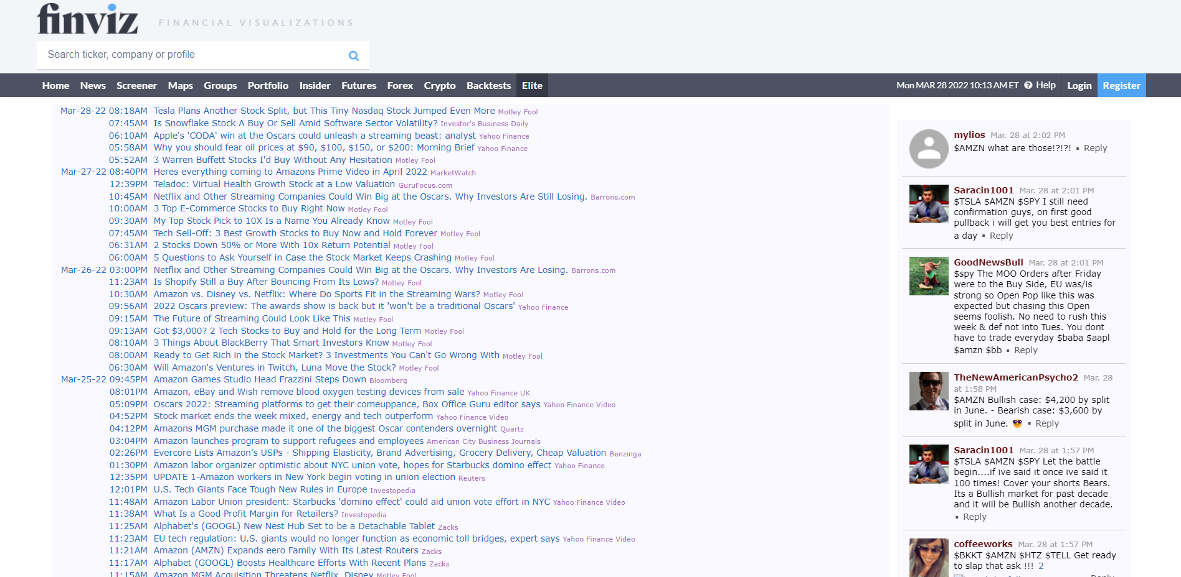
SENTIMENT ANALYSIS
To perform Sentiment Analysis-
We'll use Beautifulsoup in Python to scrape article headlines from FinViz
Then, we'll use Pandas (Python Data Analysis Library) to analyze and run sentiment analysis on the article headlines
Finally, we'll use Matplotlib for visualization of our results

Slide 17
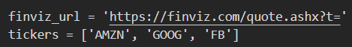
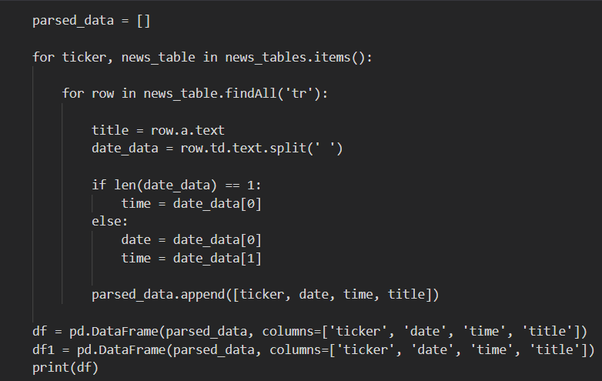
SENTIMENT ANALYSIS
Gathering and Parsing FinViz Data
FinViz is a free website that makes stock data easily accessible to traders and investors. We'll gather the stock data from FinViz for a specific stock ticker.
Here we are getting the article title / headline from finviz then we are storing the article title along with the timestamp in a dictionary.
Then we parse through the table contents which are made from the dictionary and select article titles and we split the timestamp into date and time components. At the end of this step we have scraped the components which are needed for Sentiment Analysis ie. tickers , date , time and article title.

Slide 18
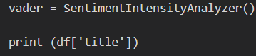
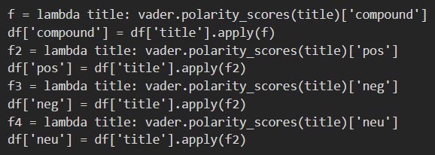
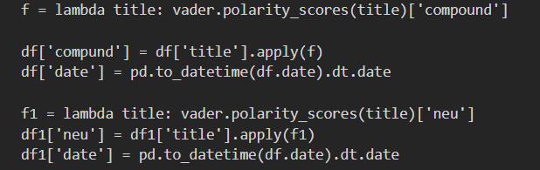
SENTIMENT ANALYSIS
2. Applying Sentiment Analysis
Applying sentiment analysis on the titles is done with NLTK (Natural Language Toolkit) vader that allows us to pass in a string into its function:

Slide 19
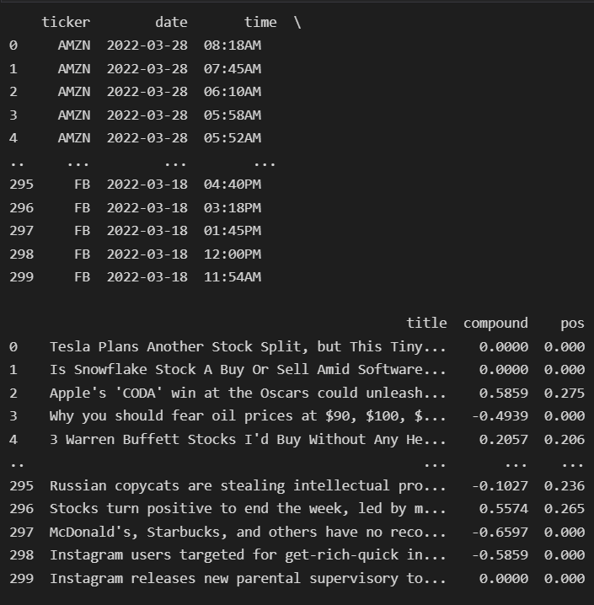
SENTIMENT ANALYSIS
We initialize the SentimentIntensityAnalyzer, and then create a lambda function that takes in a title string, applies the vader.polarity_scores() function on it to get the results in the above image and then only returns back the compound score. Using the apply function in Pandas, we can create a new 'compound' column in the data frame with all the compound scores from each title.
3. Visualizing the Results in MatPlotLib
We visualize the data frame in MatPlotLib to see how our Stocks fared every day from public perception in news articles. For that we group our dataset based on the ticker and dates of each row, and then visualize the average compound score of each day.

Slide 20
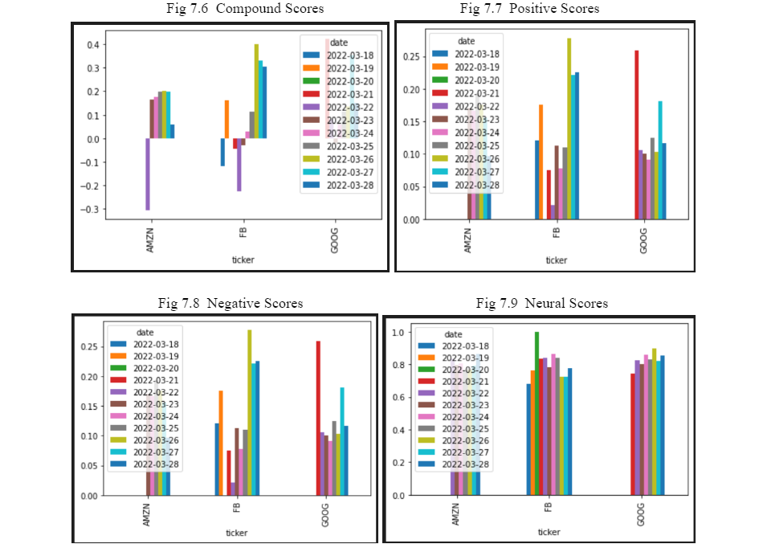

Slide 21
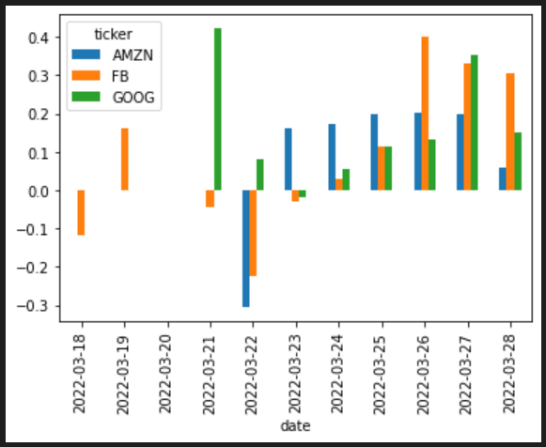
These graphs give us an idea about whether the daily news of a particular company is positive or negative and whether one should invest in it or not. Each graph has bars of different days and we have done that for three companies.
This bar chart tells us what the average score of each company is for the past 9 days. This will make it easier to compare between different companies. Here we took the cross section of the compound score row, flipped the data frame so that we have the dates as the x-axis, and then plotted it as a Bar chart -

Slide 22
TRADING AGENTS
These agents will help sketch a stock trend and will also develop an investment plan for a particular company. The two agents as we call them are based on popular techniques/ stock market strategies which are tremendously used. The two agents are Turtle Agent which is based on Turtle Trading Strategy and Moving Average Agent which uses Moving average indicator. The output of the deep learning models (specifically GRU as it is giving the most accurate result) will be used as input for our agents, this will let it predict and plan the investment strategy which the user needs to follow to maximize profit.

Slide 23
MOVING AVERAGE AGENT
Moving average (MA) in the stock market is basically a stock indicator, it is a technical tool that helps in analysis which smooths out cost data by making a continually refreshed typical cost. A moving normal (MA) is a generally utilized specialized indicator, here we will be using the moving average to determine points when one should buy / sell stocks.
Indication to sell or buy a stock/asset is based on the calculated estimation of MA. At the point when resource costs get over their moving midpoints, it might produce an exchange signal for specialized brokers.
Moving average crossovers are a well known procedure for both entries and exits. MAs can likewise feature areas of possible help or opposition.
It's assumed that when the price is above a MA, then the trend is considered to be up. If the price is below a MA, the trend is known to be down.

Slide 24
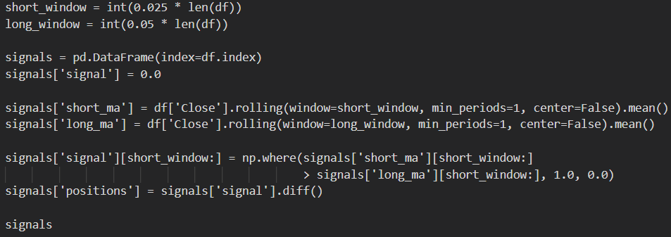
MOVING AVERAGE AGENT
Whenever the short-term moving average crosses over the long-term moving average, it's supposed to be a purchase signal, because the way the pattern moves is considered to be moving up. It is known to be a golden cross.
In the interim, the time when the short-term moving average crosses underneath the long-term moving average, that depicts a sell signal, as that movement of the pattern means the trend is moving down and that is known as a dead/passing cross.

Slide 25
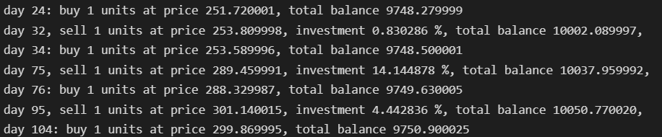
MOVING AVERAGE AGENT
This agent will sketch an investment plan which will have a day to day task of whether one should invest in a particular company’s stock or no. (eg. Microsoft)
The investment plan will be on the basis that if we assume we have Rs 10,000 then on which day should we invest how much money in a particular company’s stock and in the end how much profit/gain will we have. This plan also gives us an estimation of the investment strategy which we must follow to maximize our profit. It gives details like total net balance, total gain, total investment percentage etc. The user can compare the investment strategy for various companies and check out which company will give a maximum profit.

Slide 26
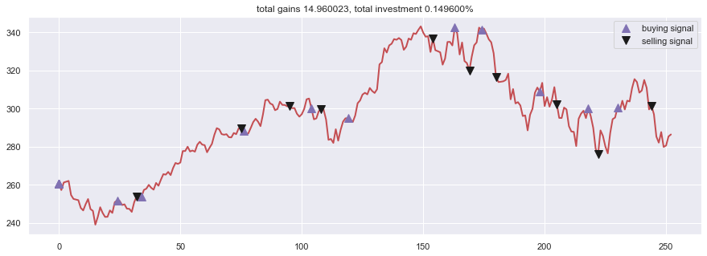
MOVING AVERAGE AGENT
Along with the textual plan, the project also has a graph depicting points (days) when to sell/ buy certain stocks of a particular company , which will make it easier to understand on which day one should buy/sell a unit of stock.

Slide 27
TURTLE AGENT
The turtle trading strategy/ methodology is a well-known pattern following the procedure that brokers use to profit from the supported force in the exchanging market. Utilized in a large group of monetary business sectors, dealers utilizing this methodology search for breakouts, to potential gain and disadvantage.
The thought is just the "pattern is your companion", so you ought to purchase potential gain of exchanging reaches and undercut drawback breakouts.
The strategy is based on these rules -
The exchanging markets rule
The position-measuring rule
The passages rule(Entries)
The stop-misfortune rule
The ways out rule
The strategies rule

Slide 28
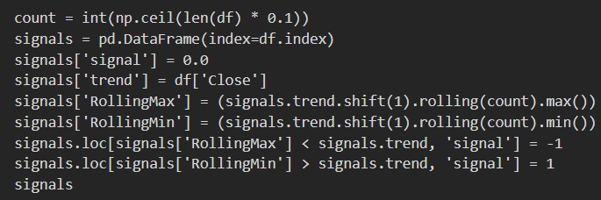
TURTLE AGENT
It uses the typical genuine reach to work out unpredictability, and utilizes it to change your position size. It Takes bigger situations in less unstable business sectors and reduces your openness to the most unpredictable business sectors.
It uses average true range to calculate volatility and use this to vary your position size. Take larger positions in less volatile markets and lessen your exposure to the most volatile markets.

Slide 29
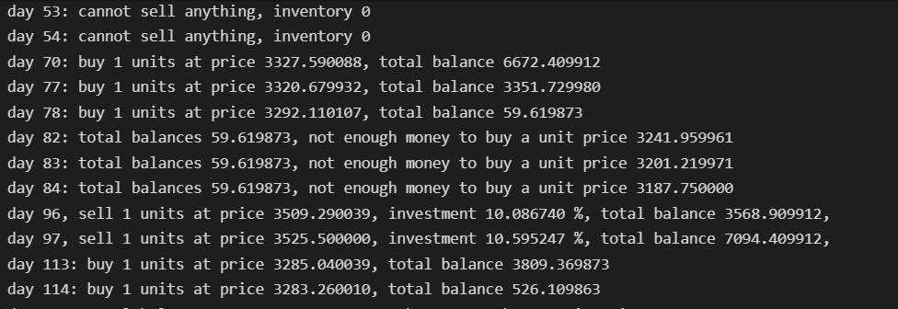
TURTLE AGENT
Similarly, the Turtle agent also gives us an investment plan. This agent uses the turtle strategy to draft the investment plan. It will give us an idea in advance about how one should plan the investment.

Slide 30
TURTLE AGENT
This agent uses the turtle strategy to draft the investment plan. It will give us an idea in advance about how one should plan the investment. This graph depicts (days) when to sell/ buy certain stocks of a particular company, it will make it easier to understand on which day one should buy/sell a unit of stock.

Slide 31
COMPARATIVE ANALYSIS
Compared the MAPE accuracies of the 3 different deep learning model, (RNN, LSTM and GRU).
We took 22 companies of varying stock trend in the recent year as given below.
The colour depicts the colour of the graph in the table.
The model that works best in all of the above situation (GRU), was further used as the input trend in trading agents to make a similar comparison between Moving Average and Turtle Agent.
Unstable Stocks
Stock Losers
Stock Gainers
Stable Stocks

Slide 32
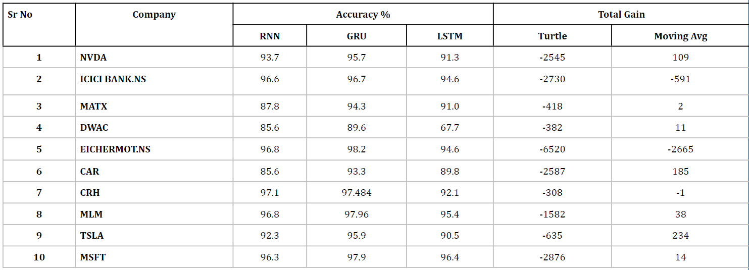
COMPARATIVE ANALYSIS

Slide 33
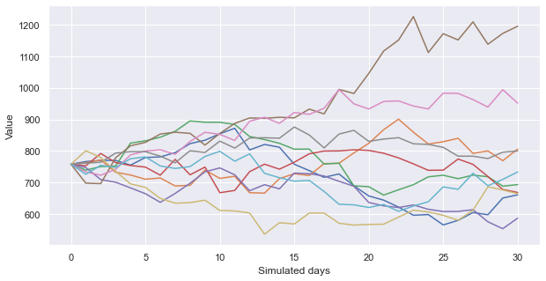
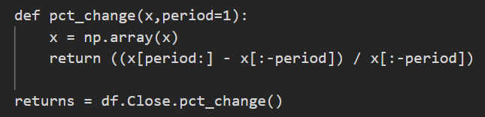
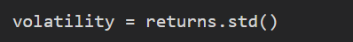
VISUALIZATION
Monte Carlo simulation
As we hear about the growth of Tesla Motors and how Elon Musk boosted the company but there may be loopholes so we thought of using this data to use for Monte Carlo Simulations which is useful in case of uncertainties as Tesla Motors.

Slide 34
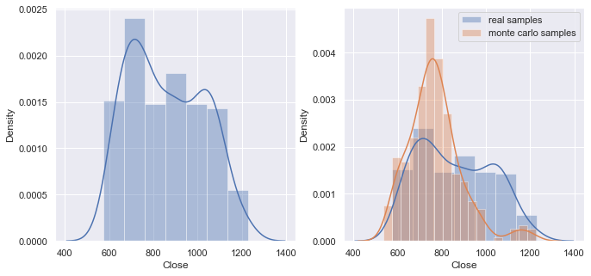
Monte Carlo simulation Results
It is useful in predicting uncertain values as random numbers are chosen based on likely outcomes of whether the closing values are high or low and how it will help take calls for future making the simulation extremely useful.

Slide 35
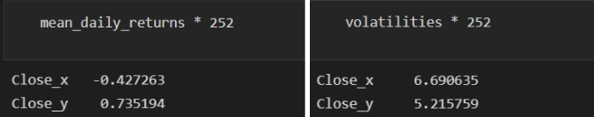
VISUALIZATION
B) Joint Plot Simulation
We took a dataset of 11 companies and then computed returns and volatilities and then used a joint plot function available in seaborn library of python for which we used regression mode. This reg mode draws the line of best fit which demarcates and compares the buying and selling of all the stocks feeded and helps us to take calls in future.
We then computed returns and volatilities as mentioned above and then used jointplot function available in seaborn library of python for which we used regression mode-
g = sns.regplot("volatility", "returns", data=combine)

Slide 36
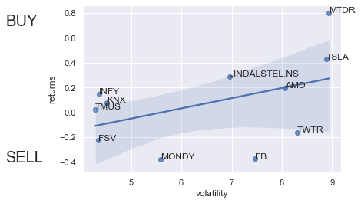
Joint Plot Simulation Results
Twitter and FB as per jointplot are not worth buying as their prices fluctuate a lot and did not yield significant return in comparison to other stocks.
AMD is on edge implies hold if bought else no need to buy.
From the jointplot graph it is clearly evident that Jindal steel, Matador industries and Tesla will give high returns despite high volatilities implying the stocks are worth investing in for a decent amount of period not for long as prices fluctuate quite often.
TMUS, INFY and KNX yield good returns despite low volatilities implying stocks are worth buying for the long term as prices don’t fluctuate much.

Slide 37
CONCLUSION
The main idea of this project is to make a prediction model which could help people trade in the stock market despite being inexperienced in the stock market.
We all know the stock market is a risky game and models or algorithms are not 100% correct every time but with the help of this project are trying to implement a model as accurate as possible keeping the current trend in mind.
A visual comparison of various stock models on the basis of which a person will be able to take calls regarding buying and selling of a particular stock is shown.
To identify this pattern we have used Markov Chain Models particularly Monte Carlo Simulations which searches for a pattern in the data set and makes predictions on the basis of it
Then with the help of deep learning we could make understanding stock market workload easy for analysts and even for customers who want to start trading by investing in stocks despite little knowledge.
Sentiment analysis is used to understand financial news and make decisions on stock market investments.

Slide 38

THANK YOU
SANCHITA SURYAVANSHI
18BCE0506
KAREN PINTO
18BCE0596

